Slide 1


Noisy Data and Pruning Techniques in Machine Learning
Noisy data is a common challenge in machine learning, affecting model accuracy and generalization. Noise in data refers to irrelevant, incorrect, or misleading information that can distort model training. To counteract this issue, various pruning techniques are applied to simplify models, remove redundant information, and enhance predictive performance.

Slide 2

Understanding Noisy Data in Machine Learning
What is Noisy Data?
Impact on Models
Noisy data refers to irrelevant, incorrect, or misleading information that can distort model training. It presents a common challenge in machine learning, affecting model accuracy and generalization.
Noise in data can significantly impact the learning process, causing models to capture irrelevant patterns instead of meaningful relationships in the data.
Need for Solutions
To counteract this issue, various pruning techniques are applied to simplify models, remove redundant information, and enhance predictive performance.

Slide 3
Sources of Noisy Data
1
Measurement errors
2
Human errors
3
Outliers
Inaccuracies in data collection that introduce noise into datasets.
Incorrect labeling or input mistakes made during the data entry process.
Extreme values that deviate from expected patterns and can skew model training.
4
Environmental factors
5
Irrelevant features
Sensor malfunctions, network issues, and other external factors affecting data quality.
Unnecessary attributes that increase model complexity without adding predictive value.

Slide 4




Effects of Noisy Data
Reduced Accuracy
Increased Training Time
Overfitting Issues
Reduces model accuracy and interpretability, making predictions less reliable.
Increases training time and computational costs as models struggle to find patterns.
Leads to overfitting, where models learn from noise instead of underlying patterns.

Slide 5
Techniques for Handling Noisy Data: Overview
Data Cleaning
1
Methods to identify and remove or correct noisy data points
Feature Selection
2
Approaches to identify and focus on the most relevant features
Data Augmentation
3
Techniques to enhance datasets and build model robustness
To improve model robustness, various techniques can be applied to manage noisy data. These approaches work at different stages of the machine learning pipeline, from preprocessing to model training.

Slide 6
Data Cleaning Techniques
Outlier Detection and Removal
Imputation Techniques
Noise Filtering
Filling missing values with mean, median, or mode to create a complete dataset that can be more effectively used for model training.
Using clustering or similarity-based methods to remove anomalies and smooth out noisy patterns in the dataset.
Using statistical methods like Z-score, IQR, or machine learning approaches such as Isolation Forest to identify and remove extreme values that could negatively impact model training.

Slide 7




Feature Selection Techniques
Principal Component Analysis (PCA)
Reduces dimensionality and filters noise by transforming the data into a new coordinate system where the greatest variances lie on the new axes.
Mutual Information & Chi-Square Tests
Identify relevant features by measuring the dependency between variables and target outcomes.
Wrapper Methods
Iterative selection using models like Recursive Feature Elimination (RFE) to progressively remove less important features.

Slide 8

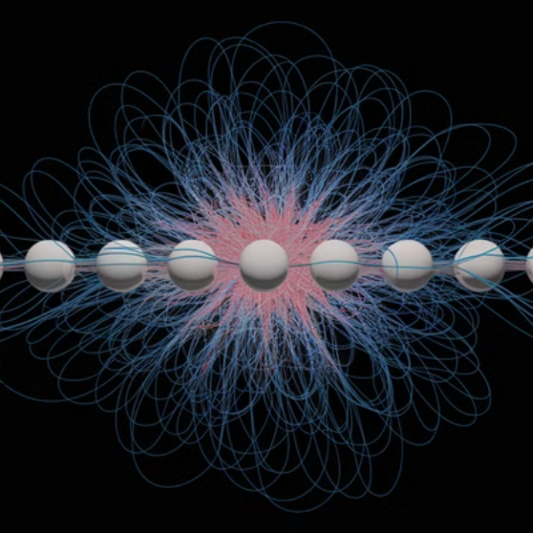

Data Augmentation Techniques
1
SMOTE (Synthetic Minority Over-sampling Technique)
2
Noisy Data Augmentation
Controlled noise injection to enhance model robustness by exposing the model to various potential distortions during training.
Balances class distributions by creating synthetic examples for minority classes, helping models learn rare patterns better.

Slide 9




Introduction to Pruning Techniques
Improved Efficiency
1
Faster inference time
Reduced Overfitting
2
Better generalization
Simplified Model
3
Removal of redundant parameters
Base Model
4
Complex with unnecessary components
Pruning is a method used to remove unnecessary parameters or nodes from machine learning models to reduce overfitting and improve efficiency. It acts as a form of regularization that helps models generalize better to unseen data.

Slide 10


Decision Tree Pruning
Pre-Pruning (Early Stopping)
Post-Pruning (Cost Complexity Pruning)
Halts tree growth based on constraints like depth or minimum samples per split. This approach prevents the tree from becoming too complex during the building phase.
Removes branches with minimal impact on accuracy using techniques like Reduced Error Pruning. This is done after the tree is fully constructed to optimize its structure.

Slide 11



Neural Network Pruning
Neuron Pruning
2
Removes redundant neurons
Weight Pruning
1
Eliminates small weights in neural networks
Structured Pruning
3
Removes entire layers or channels
Neural network pruning involves systematically removing components of the network while maintaining accuracy. Weight pruning eliminates small weights in neural networks, reducing complexity. Neuron pruning removes redundant neurons while maintaining accuracy. Structured pruning removes entire layers or channels in convolutional networks for more efficient computation.

Slide 12

Model-Based Pruning
L1/L2 Regularization
1
Enforces sparsity to remove redundant weights by adding penalty terms to the loss function based on weight magnitudes.
2
Dropout
Prevents co-adaptation by randomly dropping neurons during training, effectively training an ensemble of sub-networks.
Magnitude-Based Pruning
3
Removes weights below a certain threshold, assuming smaller weights contribute less to the final output.

Slide 13

Applications in Healthcare
99.5%
60%
Diagnostic Accuracy
Model Size Reduction
Potential accuracy after noise removal in medical imaging.
Typical reduction in model size after pruning for medical applications.
3x
Processing Speed
Improvement in processing speed for real-time diagnostics.
Healthcare applications benefit significantly from noise handling and pruning techniques. Removing noise from medical images is crucial for accurate diagnosis, allowing healthcare professionals to make better-informed decisions. Pruned models can run efficiently on medical devices with limited computational resources.

Slide 14




Applications in Finance and Autonomous Systems
Fraud Detection
Detecting fraud while filtering irrelevant transaction data. Pruned models can process millions of transactions in real-time with higher accuracy.
Risk Assessment
Cleaner data leads to more accurate risk profiles and better financial decision-making.
1
2
Autonomous Vehicles
Robotics
4
3
Pruning deep learning models for real-time inference in autonomous driving systems, ensuring quick response times.
Efficient processing of sensor data in robotic systems through noise filtering and model optimization.

Slide 15

Conclusion
Validate Results
Implement Pruning
Ensure that noise handling and pruning enhance rather than degrade performance.
Apply Appropriate Cleaning
Use model-specific pruning methods to optimize performance.
Identify Noise Sources
Understand where noise comes from in your specific data context.
Select suitable techniques based on the type of noise present.
Handling noisy data and applying pruning techniques are crucial for developing robust and efficient machine learning models. Proper data cleaning, feature selection, and pruning strategies can significantly enhance model performance and generalization while reducing computational costs.

